Slide 1



PaNOSC and Research Data Management
12 March, 2021
Presenter: Andy Götz (PaNOSC coordinator @ ESRF)
Meeting: Battery2030+ RDM workshop
Venue: Online
This project has received funding from the European Union’s Horizon 2020 research and innovation programme under grant agreement No. 823852

Slide 2
Outline of talk
What are the benefits of Research Data Management (RDM)?
How is PaNOSC approaching RDM?
Requirements for FAIR RDM
Lessons learned
This project has received funding from the European Union’s Horizon 2020 research and innovation programme under grant agreement No. 823852

Slide 3
What are the benefits of RDM
What do I get out of this as a researcher? Why is all this even worth the effort?
What do we achieve that could not be achieved without RDM, FAIR data and guidelines?
What can we learn from other disciplines (e.g., pharmaceutical research, astrophysics etc.) that have perhaps faced similar issues in connecting the community and have mastered those?
What can be practically done to move forward? What should be the steps the (European) battery community might want to take, in order to benefit from RDM, FAIR data, and from developing harmonized guidelines and standards for experimental and modelling work?
This project has received funding from the European Union’s Horizon 2020 research and innovation programme under grant agreement No. 823852

Slide 4
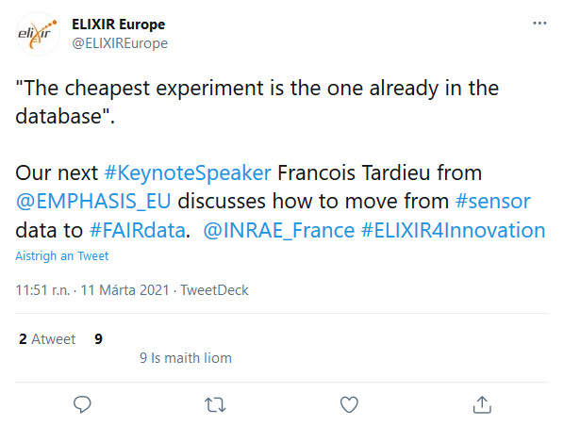
RDM = Making the most of data
“The cheapest experiment is the one already in the database”
“Cost of curating research data is a fraction of the cost of producing the data (in many cases)”
This project has received funding from the European Union’s Horizon 2020 research and innovation programme under grant agreement No. 823852

Slide 5
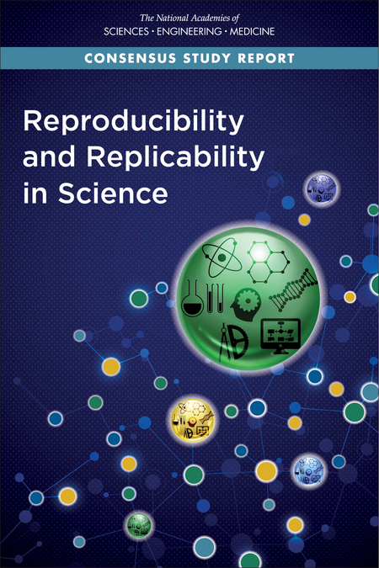

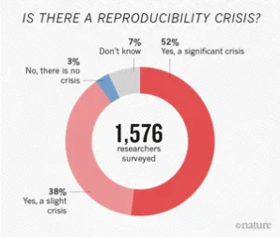
Reproducibility crisis in science
Baker, M. 1,500 scientists lift the lid on reproducibility. Nature 533, 452–454 (2016) doi:10.1038/533452a
This project has received funding from the European Union’s Horizon 2020 research and innovation programme under grant agreement No. 823852

Slide 6



PaNOSC factsheet
Call: Horizon 2020 InfraEOSC-04
Partners: ESRF, ILL, XFEL.EU, ESS, CERIC-ERIC, ELI-DC, EGI
Description: cluster of ESFRI Photon and Neutron sources
Observers/non-funded: GÉANT, EUDAT, national Ris
Co-funded project: ExPaNDS (national RIs)
Linked 3rd parties via EGI: DESY, STFC, CESNET
Status: Started 1/12/2018
Github: https://github.com/panosc-eu
Home page: https://panosc.eu
Twitter: @PaNOSC_eu #PaNOSC
Budget: 12 M€
Coordinator: ESRF
Started: 1/12/2018
Ends: 1/12/2022
Duration: 4 years

Slide 7
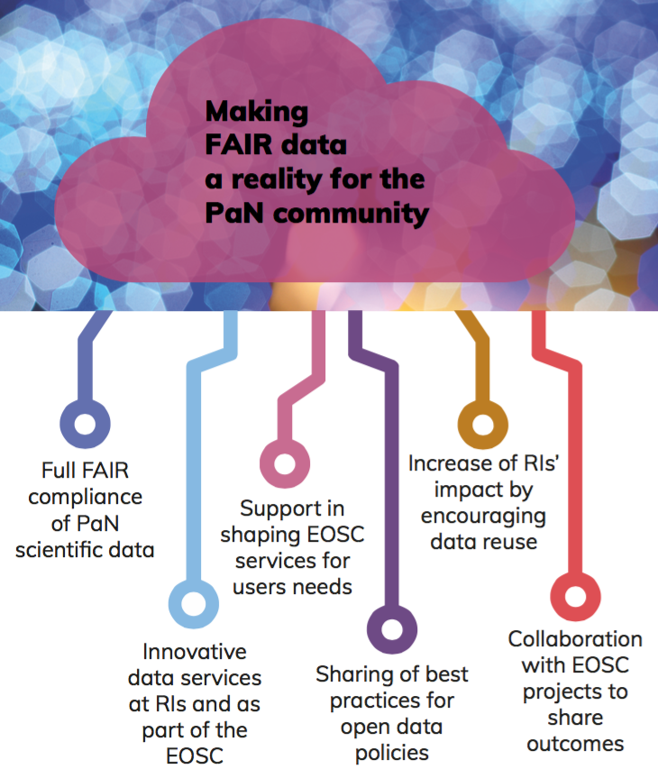
PaNOSC goals
PaNOSC works closely with the PaN sources in Europe to develop common policies, strategies and solutions in the area of FAIR data policy, data management and data services, integrating them into the EOSC.
This project has received funding from the European Union’s Horizon 2020 research and innovation programme under grant agreement No. 823852

Slide 8
PaNOSC = data policy + management + analysis + simulation + training
WP2
WP3
WP4
WP5
WP8
FAIR
Data Policy
DMP
Certify
Storage
FAIR
Metadata elogbook
Data Format
Data
Portal
Analysis Portal
Jupyter notebooks
Compute resources
Algorithms
Algorithms
Jupyter
Notebooks
Compute resources
e-training platform
Training material
Workshop
Code camps
Data Policy
Metadata
Analysis
Simulation
Training
All the above services depend on RDM …
This project has received funding from the European Union’s Horizon 2020 research and innovation programme under grant agreement No. 823852

Slide 9
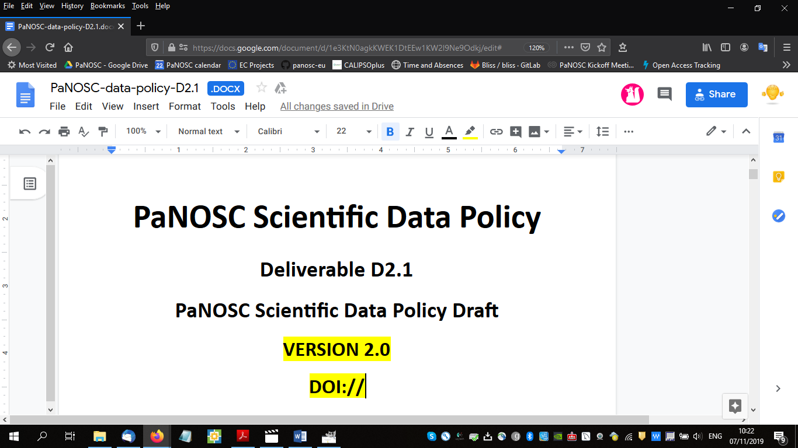
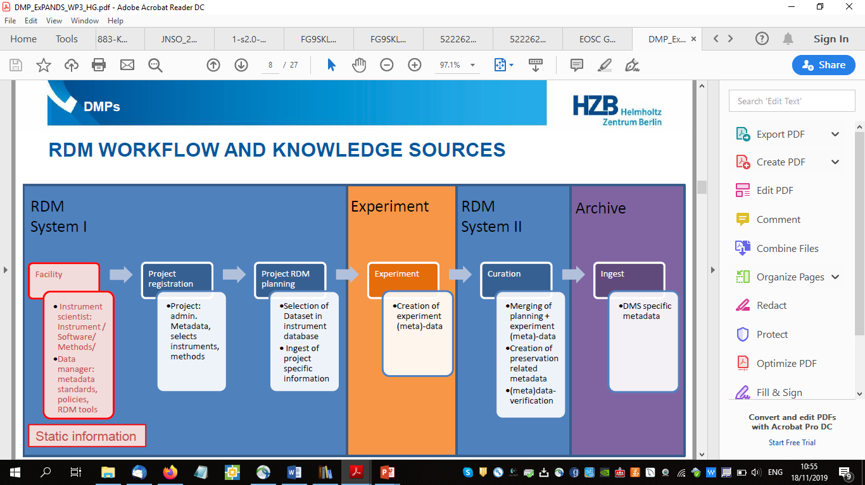
Data policy WP2
Updated the PaNdata data policy
Included the FAIR concepts to make it FAIR compliant (52 criteria)
Updating existing Data Policies to be compatible with the FAIR Data Policy framework
Current activity - adopting a tool for managing Data Management Plans together with ExPaNDS
This project has received funding from the European Union’s Horizon 2020 research and innovation programme under grant agreement No. 823852

Slide 10
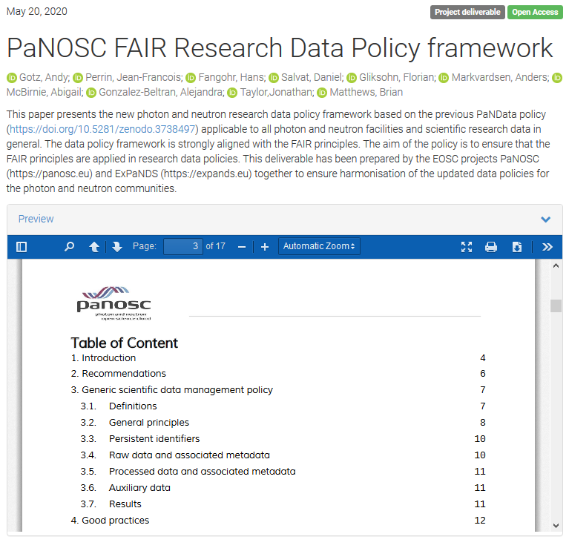
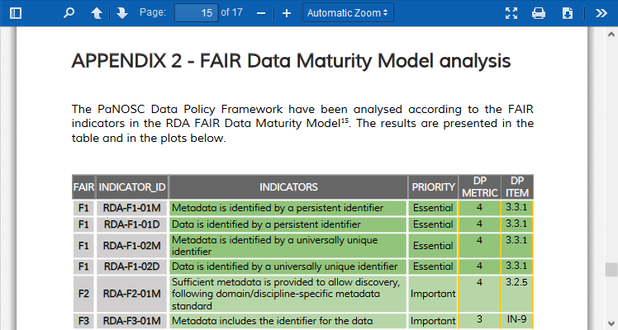
PaNOSC FAIR data policy framework
First step in RDM is to define and adopt a data policy
PaNOSC and ExPaNDS have published a FAIR data policy framework for research infrastructures

Slide 11
Main points of PaNOSC FAIR data policy framework
Explicitly mentions FAIR principles as guiding principles
Research Institute has the role to curate data
Defines different data types:
Raw, Reduced, Processed, Auxiliary, Results, Derived
Data Policy does not apply to derived data
During Embargo Period of 3 years (extendible on request) data access is reserved to the experimental team
Data become Open Data after Embargo Period
Strive to store Open Data for at least 10 years
Open Data can be accessed using a well defined protocol
Defines DOIs as preferred PID solution and must be cited
This project has received funding from the European Union’s Horizon 2020 research and innovation programme under grant agreement No. 823852

Slide 12
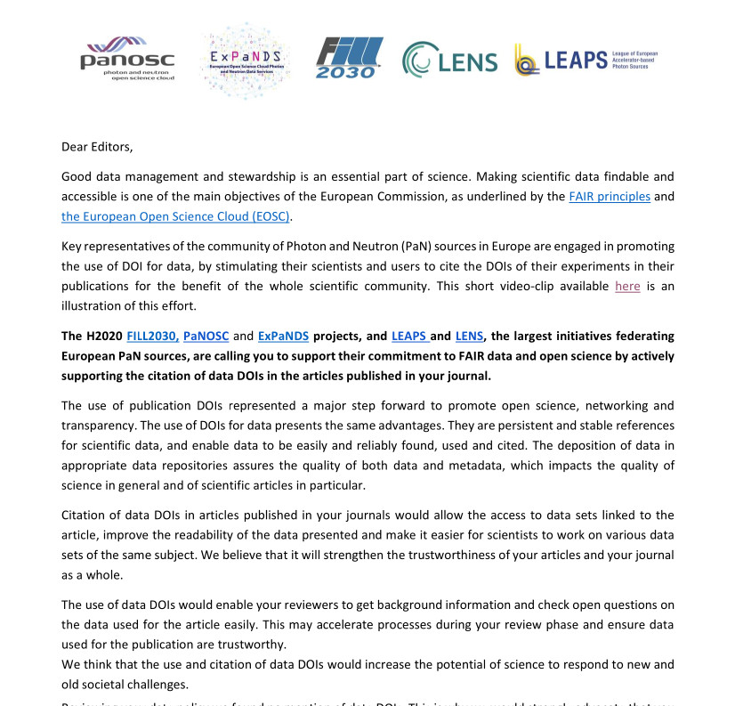

Citing Data DOIs in publications
PaNOSC, ExPaNDS, LEAPS and LENS contacted 9 journals to incite them to request data DOIs be cited in publications – impact not visible (yet)
DOI video explaining why use DOIs
https://youtu.be/ekn0qicVFJM
This project has received funding from the European Union’s Horizon 2020 research and innovation programme under grant agreement No. 823852

Slide 13
Data catalogue WP3
Develop an Application Programmers Interface (API) for searching for FAIR data
Integrate search API into EOSC portal
Using Nexus/HDF5 for metadata
Automating metadata collection on beamlines
Using e-logbook to make data FAIRer
Long term storage (100s of Petabytes)
This project has received funding from the European Union’s Horizon 2020 research and innovation programme under grant agreement No. 823852

Slide 14
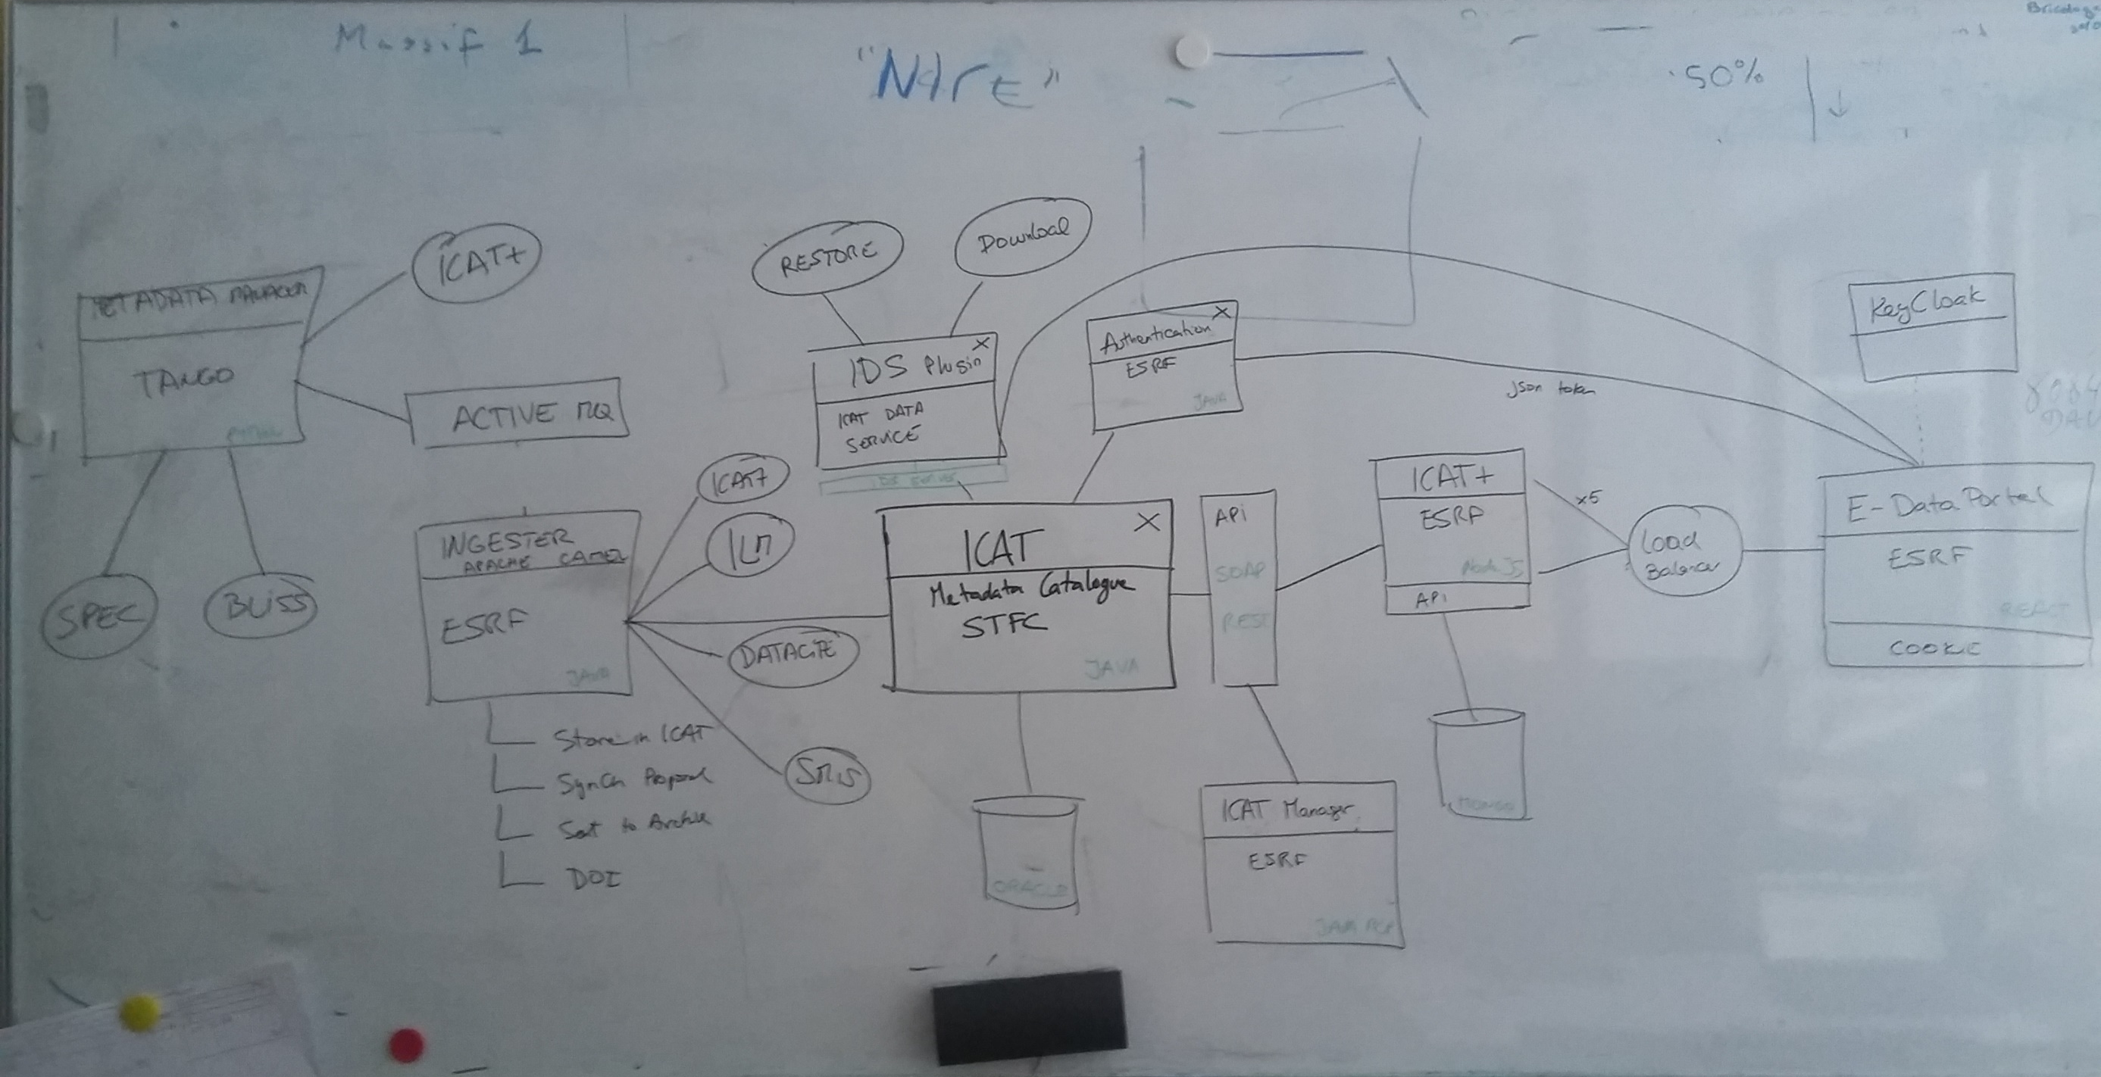
ESRF Data curation workflow
Credit: Alex de Maria

Slide 15
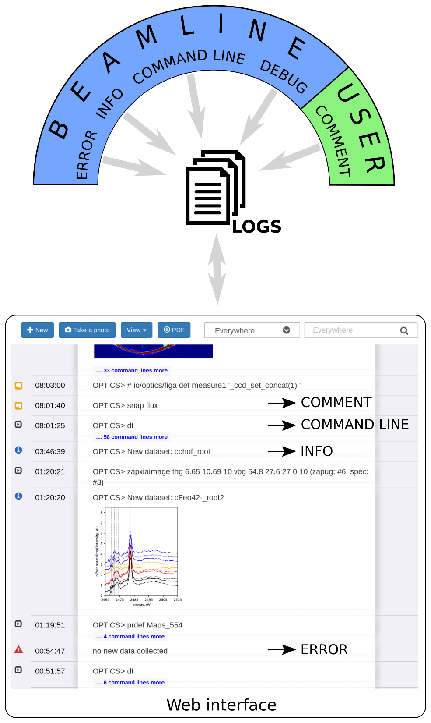
E-logbook makes experiments FAIRer
This project has received funding from the European Union’s Horizon 2020 research and innovation programme under grant agreement No. 823852

Slide 16
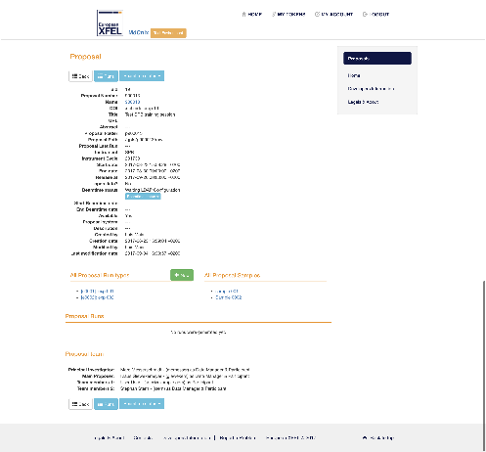
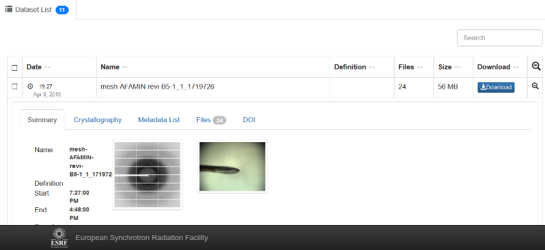
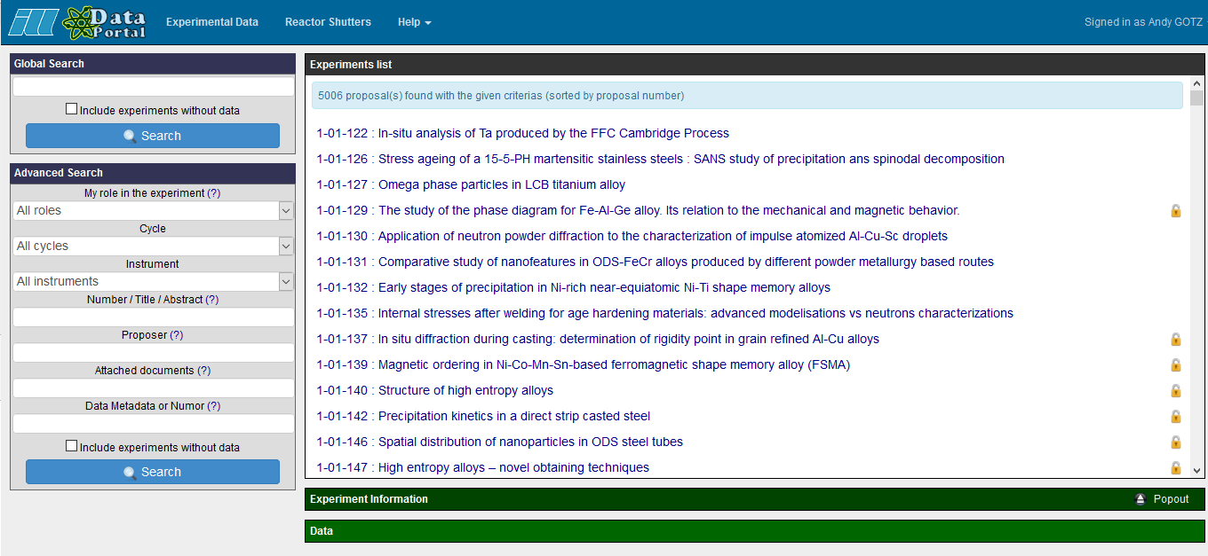
PaNOSC has 6 data catalogues with different APIs + UIs
WP3
ESRF
(icat)
CERIC
(icat)
ESS
(SciCat)
ILL
(local)
ELI
(tbd)
XFEL
(MyMdc)
50 PB/yr
15 PB/yr
<1 PB/yr
.6 PB/yr
10 PB/yr
100 PB/yr
https://data.esrf.fr
https://data.ill.fr
This project has received funding from the European Union’s Horizon 2020 research and innovation programme under grant agreement No. 823852

Slide 17

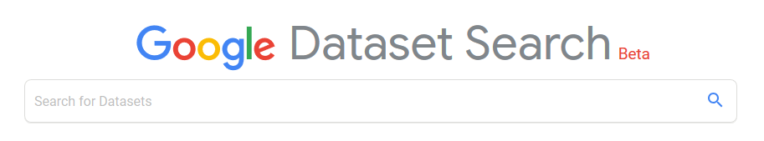
PaNOSC common API across all sites
WP3
Common API to search across all PaNOSC catalogues
ESRF
(icat)
CERIC
(icat)
ESS
(SciCat)
ILL
(local)
ELI
(tbd)
XFEL
(MyMdc)
50 PB/yr
15 PB/yr
<1 PB/yr
.6 PB/yr
10 PB/yr
100 PB/yr
This project has received funding from the European Union’s Horizon 2020 research and innovation programme under grant agreement No. 823852

Slide 18

PUMA publication search
Publications and citations per instrument
Delay between a proposal and a publication
Countries and laboratories which use ILL (ESRF, …) data
Look for potential new users
Scientific trends
Impact factor per science facility
F(AIR)inding data used in publications → DEMO
This project has received funding from the European Union’s Horizon 2020 research and innovation programme under grant agreement No. 823852

Slide 19
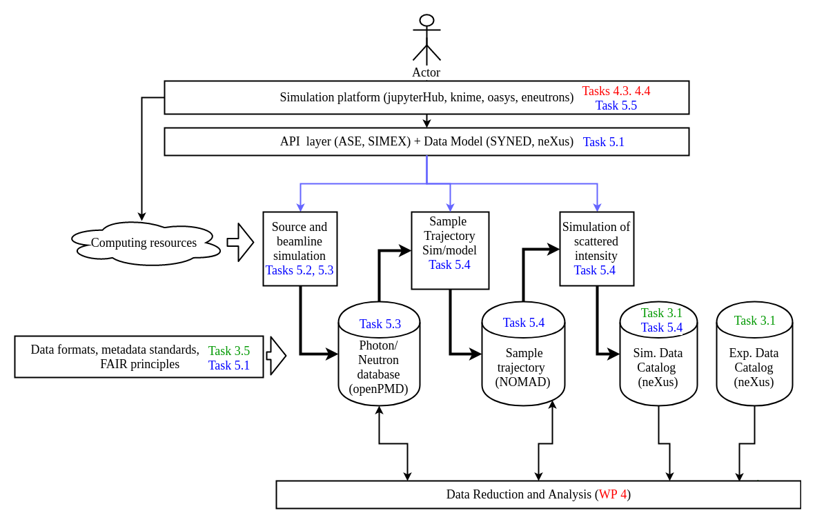
Simulation services
This project has received funding from the European Union’s Horizon 2020 research and innovation programme under grant agreement No. 823852

Slide 20

PaNOSC + ExPaNDS contribution to EOSC
Petabytes of raw and processed data in a wide variety of scientific domains
2. Meta-data that will create FAIR raw and processed scientific data
3. Software for generic and specific data simulation and data analysis
4. Workflows and expertise for reducing and analysing data
5. Reference training material and training platform for understanding photon and neutron science and associated handling of data
6. Interface to large user communities of photon and neutron sources and their expectations for services
This project has received funding from the European Union’s Horizon 2020 research and innovation programme under grant agreement No. 823852

Slide 21
PaNOSC lessons learned about RDM
Deliverable D2.3
in progress
Identify which data you need to curate. Are they simulated, raw, reduced, processed, published or all of them?
Define and adopt a FAIR Data Policy. Consult the many resources out there
Hire data managers (at least 2), identify experts for metadata. Failure to do so means there is a strong risk that the data policy is not implemented.
Choose and provide a single solution for software and infrastructure. Needs to be sustainable in the long term.
Implement above solutions to provide access to FAIR data. Use an existing solution.
Provide services on top of RDM. Examples are search, metrics, download, analysis tools
This project has received funding from the European Union’s Horizon 2020 research and innovation programme under grant agreement No. 823852

Slide 22
PaNOSC lessons learned about FAIR
It is a long but useful process. Not to be underestimated but worth it – needs support
Quality of data+metadata improves. Metadata and curation improved a lot.
Strengthens collaboration with community standards bodies. Standards adopted for data formats + ontologies.
Data services can be provided. Remote access, search, analysis e.g. jupyter notebooks
Data can be cited and accessible. Still needs stronger support from journals.
More and more Open Data are now available. ESRF and ILL data embargo ending
(FA)Interoperability and Reusability are still to be achieved. The Holy Grail !
This project has received funding from the European Union’s Horizon 2020 research and innovation programme under grant agreement No. 823852

Slide 23
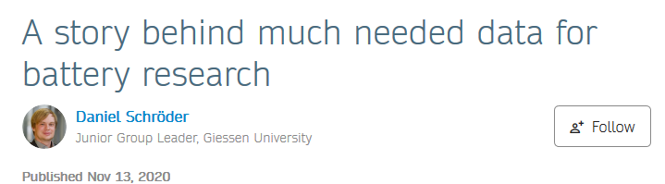
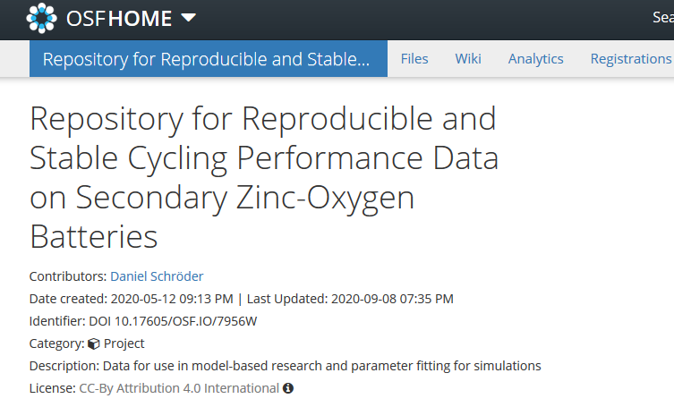
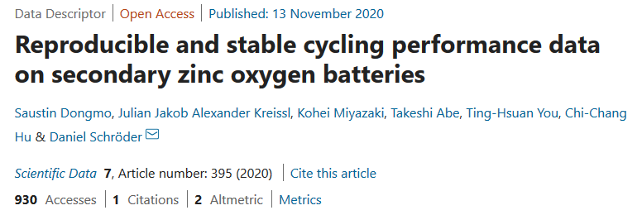
What is the situation for data in battery research?
Q: Is this example representative for battery research?
This project has received funding from the European Union’s Horizon 2020 research and innovation programme under grant agreement No. 823852
This project has received funding from the European Union’s Horizon 2020 research and innovation programme under grant agreement No. 823852

Slide 24
Conclusion
PaNOSC vision is to create a Scientific Data Commons for Photon and Neutron sources and make FAIR open data available as members of the EOSC
PaNOSC lessons learned in RDM have already been adopted by PaNOSC partners. Need to be sustainable.
PaNOSC+ExPaNDS partners can provide FAIR data for battery research → an example of data (FAI)Reuse
This project has received funding from the European Union’s Horizon 2020 research and innovation programme under grant agreement No. 823852

Slide 25
PaNOSC Resources
https://panosc.eu
https://github.com/panosc-eu/panosc
“Enabling Open Science for Photon and Neutron sources” presented at ICALEPCS 2019 http://icalepcs2019.vrws.de/papers/tubpl02.pdf
PaNOSC Position Paper - https://github.com/panosc-eu/panosc/blob/master/Work%20Packages/WP6%20EOSC%20Integration/PaNOSC_EOSC_position_paper.pdf
This project has received funding from the European Union’s Horizon 2020 research and innovation programme under grant agreement No. 823852

